Slide 1
NIRICT reconnaissance topic performance and correctness of GPGPU
Marieke Huisman
Alexandru iosup
ana lucia Varbanescu
Anton wijs

Slide 2
Goal of the day
Get to know each other:
  Quick introduction round
Get inspired
Discuss what opportunities we see
Plans and organisation for the reconnaissance topic

Slide 3
10:00 opening & welcome - goal of the day and the reconnaissance theme - Marieke Huisman
10:05 Marieke Huisman - verification of OpenCL programs
10:20 Alexandru Iosup
10:40 Andrei Jalba - GPU-accelerated simulations for Computer Graphics
11:00 Jan Kuper - GPU-related work in the CAES group
11:20 Kees Vuik
11:40 Gert-Jan van den Braak
12:00 lunch
14:00 Ana Lucia Varbanescu
14:20 Anton Wijs - GPU Accelerated Verification and Verified Model-Based Development of Multi-Threaded Software
14:40 coffee break
15:00 - 17:00 discussion

Slide 4
Discussion topics
What possibilities do we see for collaboration?
What are interesting topics that you would like to know more about?
What are the most important open problems in the area of performance and correctness of GPGPU?
How often should we meet?
Should we invite other people?
How should the meetings be organised?

Slide 5
verification of openCL programs
Marieke Huisman
University of Twente, Formal methods and tools group

Slide 6
overview
Basics for program verification
  Hoare logic
  Separation logic
  Permissions
Permission-based separation logic for OpenCL
Verification of compiler directives
Future challenges

Slide 7
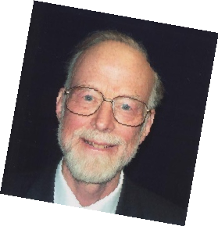
Hoare triples
{P}S{Q}
Due to Tony Hoare (1969)
Meaning: if P holds in initial state s, and execution of S in s terminates in state s', then Q holds in s'
1934 -
{P}S1{Q} {Q}S2{R}
{P}S1;S2{R}
{P ∧ b}S1{Q} {P ∧ ¬b}S2{Q}
{P}if (b) S1 else S2 {Q}
Seq
If

Slide 8
Developed for reasoning about programs with pointers
Intuitionistic separation logic
  Syntax extension of predicate logic:
    φ ::= e.f → e’ | φ → φ | ...
  where e is an expression, and f a field
  Meaning:
  e.f → e’ – heap contains location pointed to by e.f, containing the value given by the meaning e’
  φ1 → φ2 – heap can be split in disjoint parts, satisfying φ1 and φ2, respectively
  Monotone w.r.t. extensions of the heap
Two interpretations e.f → v
  Field e.f contains value v
  Permission to access field e.f
Disjointness of the heap allows reasoning about (absence) of aliasing
Local reasoning

Slide 9



John reynolds’s 70th birthday present
where no variable free in Pi or Qi is changed in Sj (if i ≠ j)
{P1}S1{Q1} .......... {Pn}Sn{Qn}
{P1 → ... → Pn} S1 || ... || Sn {Q1 → ... → Qn}

Slide 10


Permissions
John
Boyland
Permission to access a variable is a fraction between 0 and 1
Full permission 1 allows to change the variable
Fractional permission in (0, 1) allows to inspect a variable
Permissions can be split and combined
Perm(x, 1) ★−★ Perm(x, ½) ★ Perm(x, ½)
Global invariant: for each variable, the sum of all the permissions in the system is never more than 1
Thus: simultaneous reads allowed,
  but no read-write or write-write conflicts
  (data races)
Notes:
Read and write permissions

Slide 11
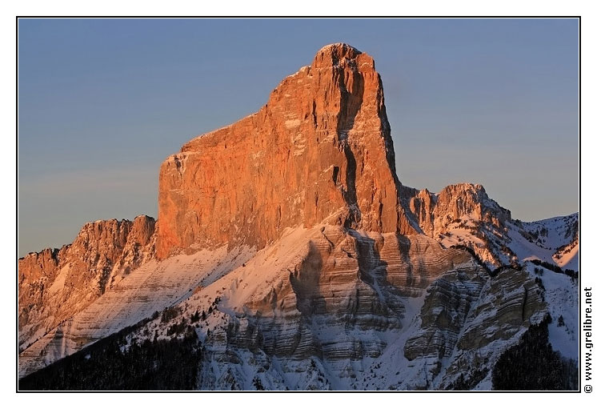
VERCORS (verification of concurrent programs)
Basis for reasoning: Permission-based Separation Logic
Java-like programs (thread creation, thread joining, reentrant locks)
OpenCL-like programs
Permissions:
  Write permission: exclusive access
  Read permission: shared access
  Read and write permissions can be
  exchanged
  Permission specifications combined
    with functional properties
VerCors
http://utwente.nL/VerCors/

Slide 12
A logic for GPU kernels
Actually:
Group specification in between kernel and thread specification
Kernel specification
  All permissions that a kernel
  needs for its execution
  Separated in permissions for
    Global Memory – given up by host code
    Shared Memory – local to the GPU
Thread specification
  Permissions needed by single thread
  Should be a subset of kernel permissions
Barrier specification
  Each barrier allows redistribution of permissions
Plus: functional specifications (pre- and postconditions)

Slide 13
Example kernel
_kernel void bla( _global float* input,
_global float* output) {
int i = get_global_id(0);
output[i] = input[i] * input[i];
barrier(CLK_GLOBAL_MEM_FENCE);
output[(i+1)%wg_size]=
output[(i+1)%wg_size] * input[i];
}

Slide 14
_kernel void bla( _global float* input,
_global float* output) {
int i = get_global_id(0);
output[i] = input[i] * input[i];
barrier(CLK_GLOBAL_MEM_FENCE);
output[(i+1)%wg_size]=
output[(i+1)%wg_size] * input[i];
}
Example specification
Provided by host
Kernel Specification:
  Global Memory Resources:
    Write permission on all entries of output
    Read permission on all entries of input
  Shared Memory Resources: -
Thread Specification:
  Resources:
    WritePerm(output[tid])
    ReadPerm(input[tid])
  Precondition: -
  Postcondition:
    output[(tid + 1) % wg_size] = input[tid] → input[(tid + 1) % wg_size]^2
Global proof obligation:
All threads together use no more resources than available in the kernel

Slide 15
_kernel void bla( _global float* input,
_global float* output) {
int i = get_global_id(0);
output[i] = input[i] * input[i];
barrier(CLK_GLOBAL_MEM_FENCE);
output[(i+1)%wg_size]=
output[(i+1)%wg_size] * input[i];
}
EXAMPLE
barrier specification
Barrier Specification:
  Resources:
    Exchange write permission on output [tid] to
    write permission on output[(tid+1) % wg_size]
    Keep read permission on input[tid]
    Obtain read permission on input[(tid+1) % wg_size]
  Precondition: output[tid] = input[tid] → input[tid]
  Postcondition: output[(tid + 1)%wg_size] = input[(tid + 1)%wg_size]^2
Global proof obligation:
All permissions available in kernel
Global proof obligation:
Barriers correctly transfer knowledge about state

Slide 16
Verification of compiler directives
GPU programming: high-level sequential programs compiled with parallellising compiler
// independent
for(int i=0; i < N; i++)
{ a[i]= 2 ∗ b[i]; }
Iteration contract:
Resources needed and returned by each iteration
/∗@ requires Perm(a[i],1) → Perm(b[i],1/2);
ensures Perm(a[i],1) → Perm(b[i],1/2);
@∗/
Can be extended with functional properties
Compilation to kernel:
Iteration contract becomes thread specification

Slide 17
Compilation to kernel:
Iteration contract becomes thread specification
LOOP with forward dependence
for(int i=0; i < N; i++)
{ a[i]=b[i]+1;
if (i>0) c[i]=a[i−1]+2; }
/∗@ requires Perm(a[i],1) → Perm(b[i],1/2) → Perm(c[i],1);
ensures Perm(b[i],1/2) → Perm(a[i],1/2) → Perm(c[i],1);
ensures i>0 ==> Perm(a[i−1],1/2);
ensures i==N−1 ==> Perm(a[i],1/2);
@∗/
Send/receive:
Transfer permissions to different iteration
Needed for verification of this iteration contract
//@ L1:if (i< N−1) send Perm(a[i],1/2) to L2,1;
//@ L2:if (i>0) recv Perm(a[i−1],1/2) from L1,1;

Slide 18
for(int i=0; i < N; i++)
/∗@ requires Perm(a[i],1) → Perm(b[i],1/2) → Perm(c[i],1);
ensures Perm(b[i],1/2) → Perm(a[i],1/2) → Perm(c[i],1);
ensures i>0 ==> Perm(a[i−1],1/2);
ensures i==N−1 ==> Perm(a[i],1/2);
@∗/
{ a[i]=b[i]+1;
//@ L1:if (i< N−1) send Perm(a[i],1/2) to L2,1;
//@ L2:if (i>0) recv Perm(a[i−1],1/2) from L1,1;
if (i>0) c[i]=a[i−1]+2; }
Corresponding
specified kernel
kernel Ref {
global int[tcount] a,b,c;
requires Perm(a[tid],1) → Perm(b[tid],1/2) →Perm(c[tid],1);
ensures Perm(a[tid],1/2) → Perm(b[tid],1/2) → Perm(c[tid],1);
ensures tid>0 ==> Perm(a[tid−1],1/2);
ensures tid==tcount−1==>Perm(a[tid],1/2);
void main(){
a[tid]=b[tid]+1;
barrier(global){
requires tid<tcount−1 ==> Perm(a[tid],1/2);
ensures (tid>0==>Perm(a[tid−1],1/2) }
if (tid>0) c[tid]=a[tid−1]+2;
}}
Permission transfer between iterations:
barrier specification

Slide 19
challenges
Scaling of the approach
Annotation generation
On-going work: OpenMP compiler directives
Correctness of compiler optimisations and other program transformations

